Slide 1
Machine Learning on Stock Market Data
Team Members:
Khushbu Parekh
Tapadyuti Maiti

Slide 2

Problem Statement
Stock Prices are totally random and unpredictable
Its volatile in nature
Foresee whether tomorrow’s exchange closing price is going to be lower or higher with respect to today
The successful prediction of a stock's future price could yield significant profit.

Slide 3

The solution
We will try to Model Financial Market Model and Predict future Stock Prices based on our Models.
Deep Learning Model on DOW 30 companies.
Sentiment Analysis from the Twitter Data for all the DOW 30 companies

Slide 4
1.Data Ingestion
We are taking the data from the YAHOO Finance as the Financial Data, from the Reddit TOP News and Twitter Feeds as input for performing sentiment Analysis.
Yahoo Finance
Twitter Data for Specific Stock Ticker
Google Trends
Link for Data 2005 - 2017
Yahoo Finance Data
Reddit News
Python Package : tweepy

Slide 5
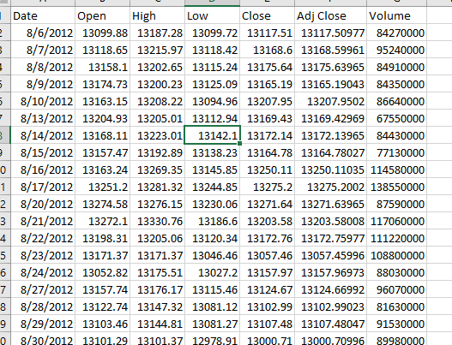
Sample Dataset :
Date : Date of Stock Exchange Operation
Open :The price of the first trade for any listed stock is its daily opening price(USD$)
High: Highest price at which a stock traded during the course of the day (in US dollars)
Low: Lowest price at which a stock traded during the course of the day (in US dollars)
Adjusted Close: price of the stock at the closing of the trading adjusted with dividends (in US dollars)
Volume: Total Number of a security that were traded during a given period of time

Slide 6
2. Data Visualization
Step 3
Step 2
Step 1
Plotting the significant Words with Finance Market Trade
Univariate / Bivariate Analysis
Get the Basic Time - Series Analysis of Stock Market Volatility

Slide 7
3.Prediction and Classification Model
Analysis on Past Stock Prices
Analysis Sales Growth on individual Stocks
Test the Model
Sentimental Analysis
Making Prediction Models
Step 1 | Step 2 | Step 3 | Step 4

Slide 8
3A.Sentiment Analysis from Twitter , Google Trend
Step 3
Step 2
Step 1
Associate with the Main Data set with Additional Features
Score the words Count and label it as Sentiment
Get the data from the Twitter regarding specific Tickers

Slide 9
3B. Analysis on Past Stock Prices
Step 3
Step 2
Step 1
Choosing the Best Model based on the test result
As this is Classification Problem , we will try to model on various Algorithm
Feature Engineering : Generate New Columns Select the best ones

Slide 10
Tools
•Python – Data processing and Machine Learning Algorithm
•Docker – For easy distribution and submission.
•Python – Web application, REST API.
•Amazon – EC2, S3.

Slide 11

Mockups

Slide 12
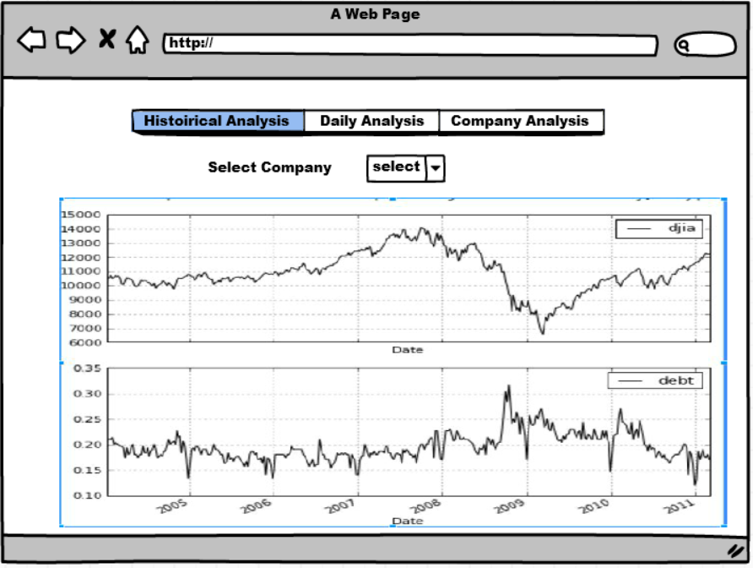

Slide 13
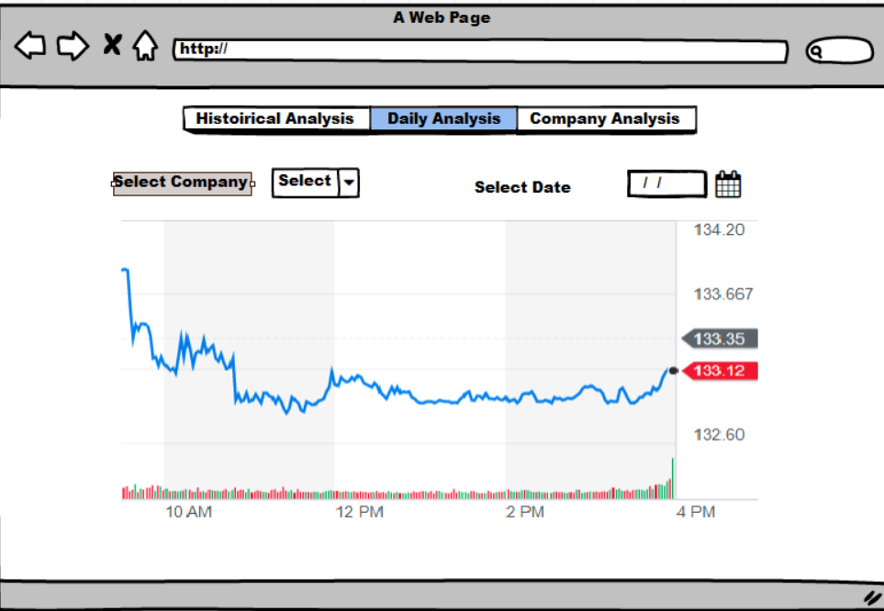

Slide 14
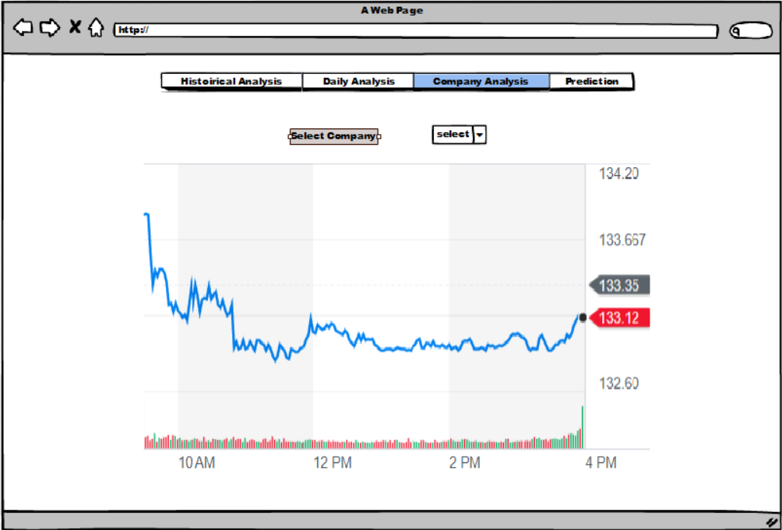

Slide 15
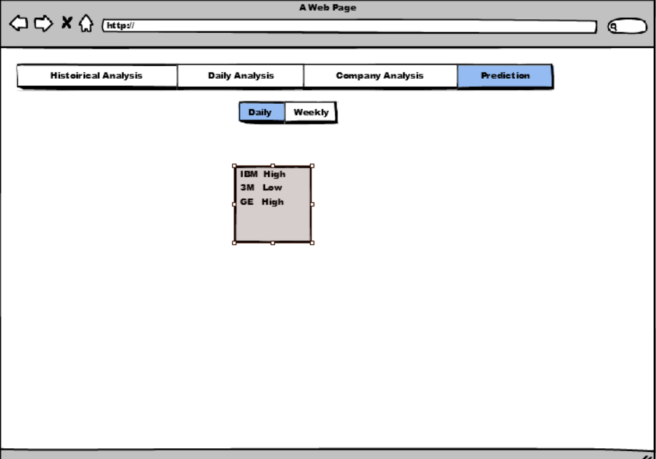

Slide 16

System Architecture
Docker
Twitter
Yahoo DOW’30
Data Ingestion
Data Wrangling
Clean Data on S3
Modelling the data - ML
Web App using Rest API

Slide 17
Youtube link: https://youtu.be/TQ-XuLxXNKo

Slide 18
Thank You !

